Slide 1
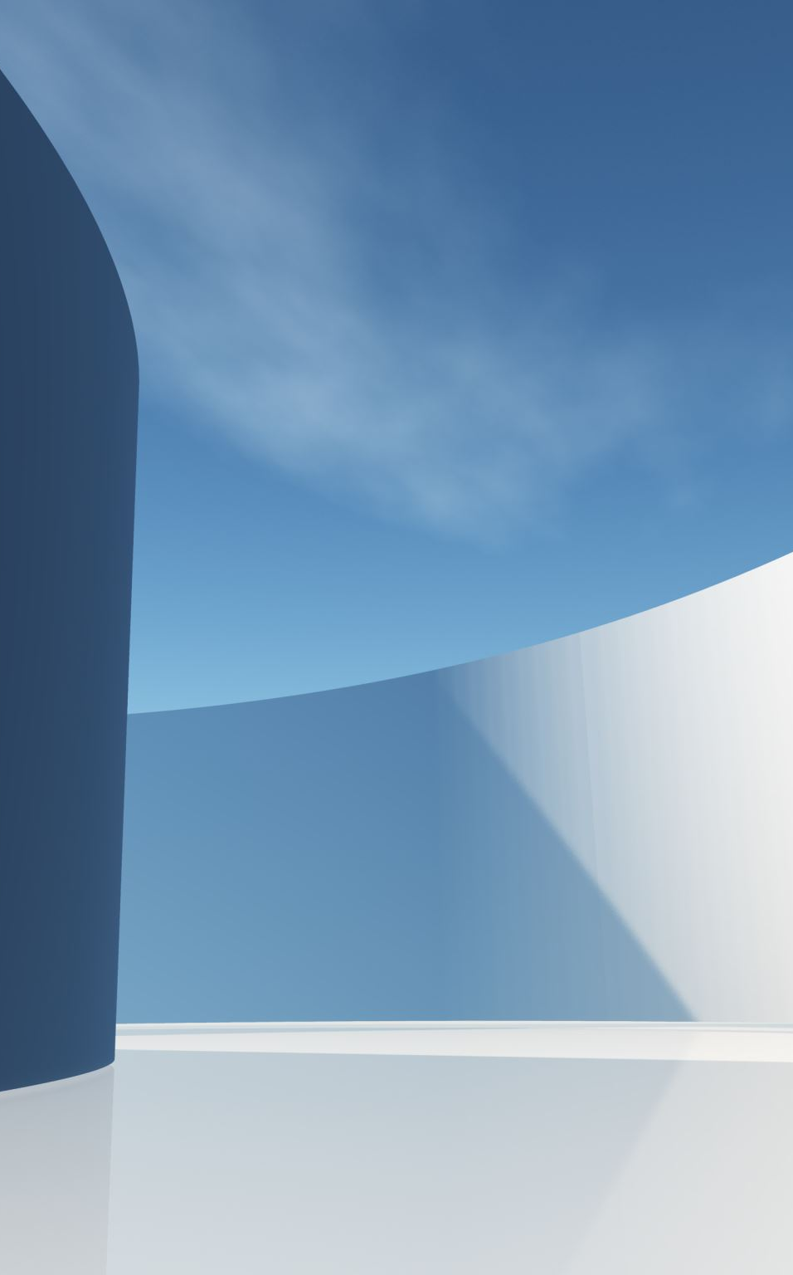
Data Mining and AI CW2: Predicting Patient Satisfaction Using Machine Learning
100571823

Slide 2
Problem and Objective
Aim: Build a model that can predict if a patient will be satisfied/unsatisfied based on a healthcare dataset.
Why?
Patient satisfaction is critical for good healthcare
Allows AI to aid services to identify improvement areas
Challenge: Binary classification with class imbalance

Slide 3
Dataset Overview
Source: Healthcare Dataset
3000 patients with 20 attributes
Target Variable: Patient Satisfaction (Rating of 1-5) (Re-framed into Unsatisfied 1-2 / Satisfied 3-5)
Class Distribution:

Slide 4
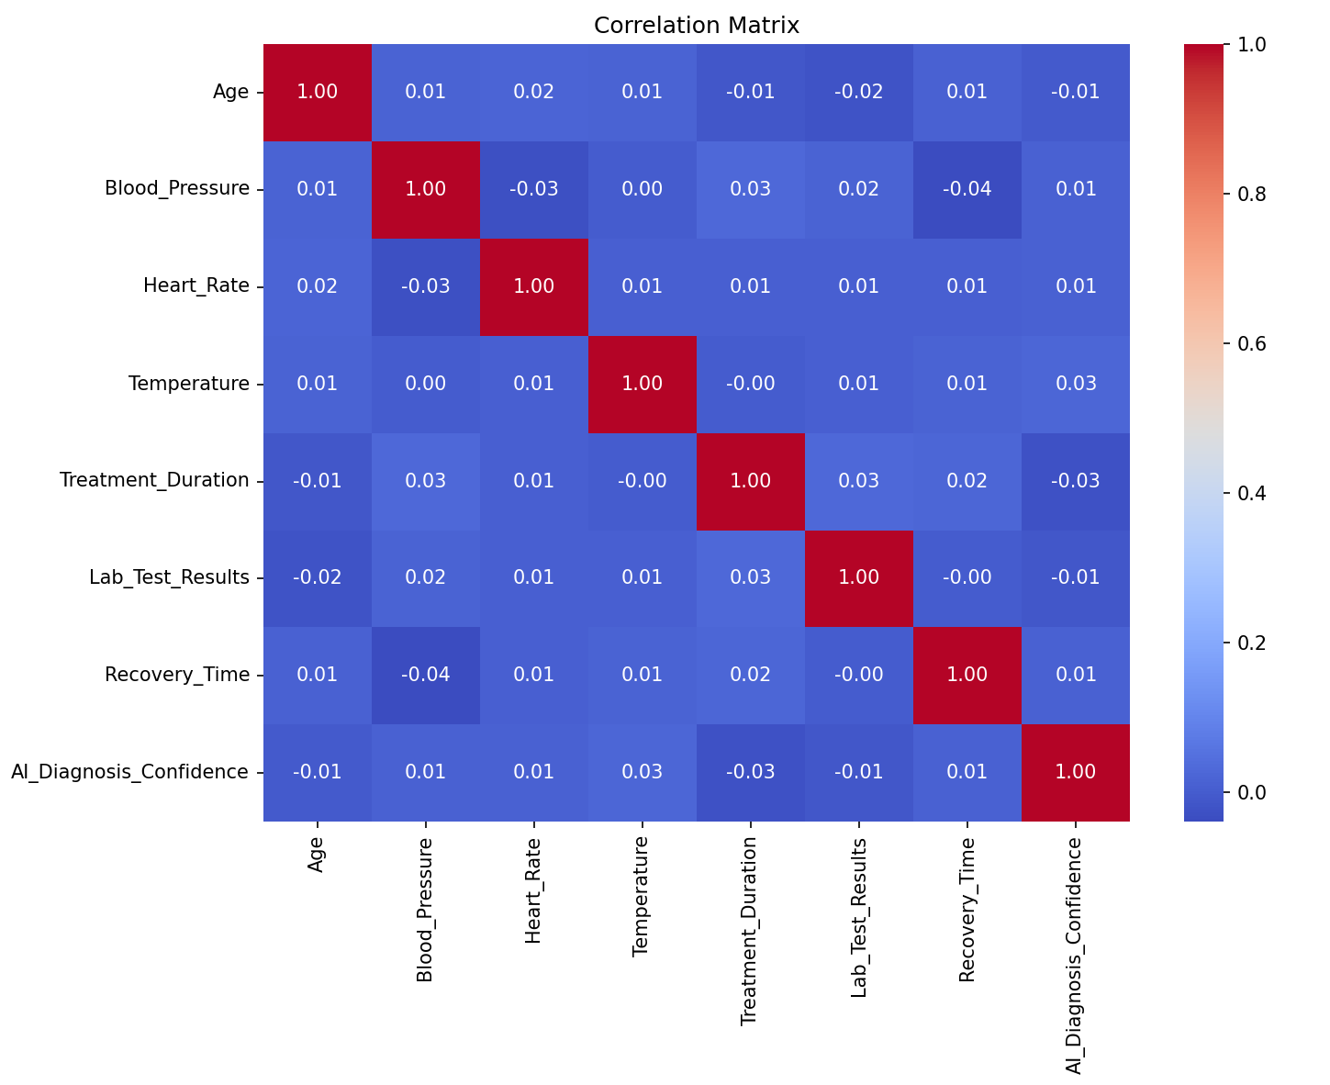
Data Preprocessing and EDA
EDA Steps
Remove Irrelevant columns (Patient ID)
Handles missing data
Scaled Numerical features (StandardScaler)
One-hot Encode for categorical feature(s) -
Apply SMOTE to balance classes
EDA Insights:
Recovery Time and Lab Results = Unsatisfied
Overall, very weak linear associations

Slide 5
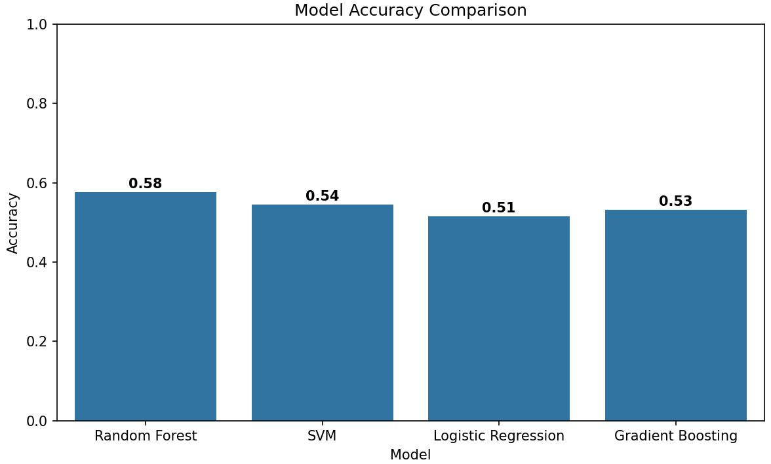
Model Comparison
Models Evaluated
Logistic regression
Random Forest
SVM
Gradient Boosting
Evaluation Metric:
Accuracy

Slide 6
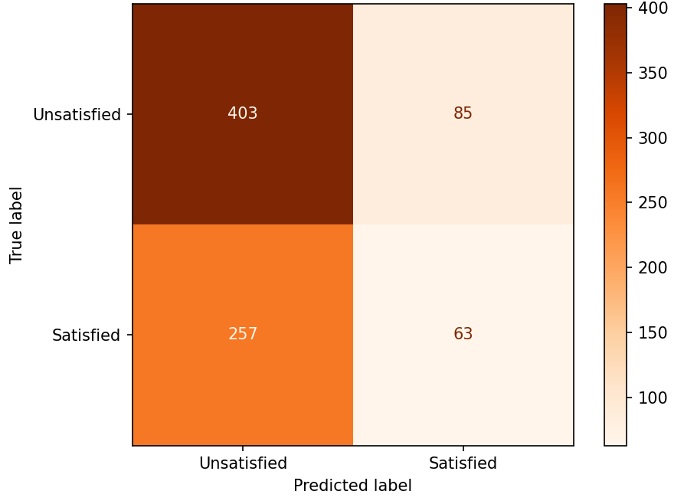
Best Model Selection
Random Forest
Highest Accuracy
Interpretable/Scalable
Effective at capturing non-linear relationships
Weak Satisfied Class recall

Slide 7
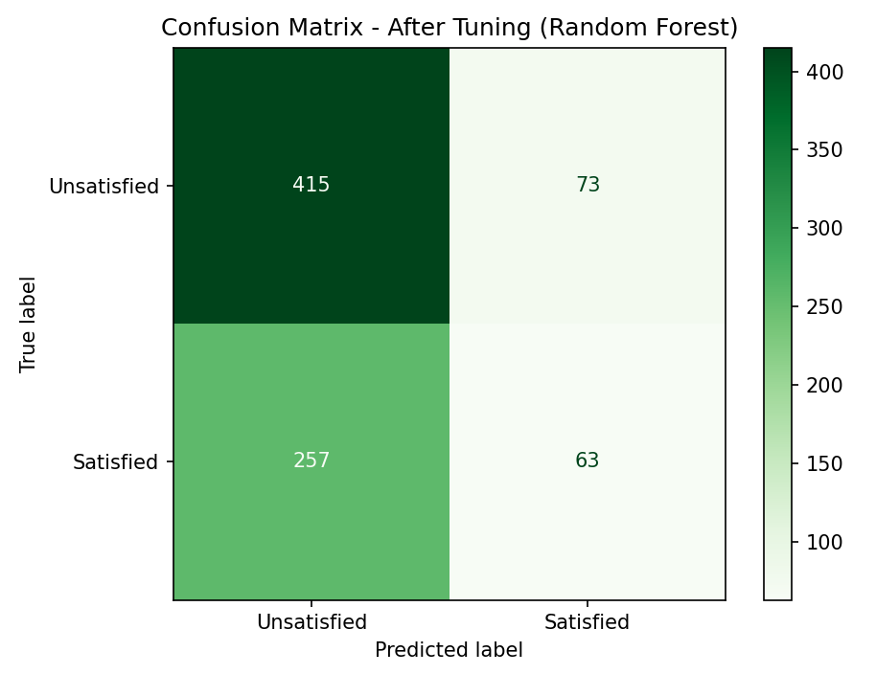
Random Forest Tuning
Random Forest Hypertuning:
RandomizedSearchCV – 240 iterations
5-fold cross validation
Best Parameters found
n_estimators: 400
max_depth: 30
min_samples_split: 4
min_samples_leaf: 2
max_features: sqrt

Slide 8
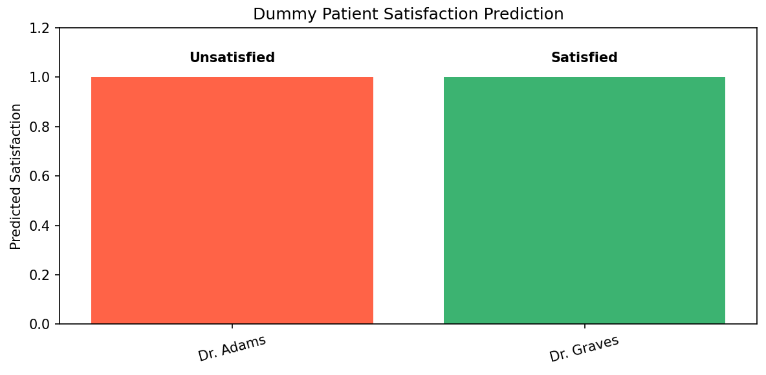
Model Evaluation
Final model Accuracy improved to 60% after Tuning
Improved classification of 'Unsatisfied' patients
Satisfied patients still struggle to classify.
Dummy Patient Testing:
Two hypothetical patients created
Biased towards either to show models capability
Model showed difficulty predicting 'Satisfied' even with highly biased inputs Insight: Even with tuning, the model remains biased toward the majority class

Slide 9
Conclusion
Model Positives:
Better prediction than random guessing by 10%
Can be used to assist decision making, raising clear cases on (un)satisfaction.
Model Limitations:
The model struggles with minority class prediction
Dummy data accuracy was limited, showing potential overfitting or feature insensitivity
Future Work:
Improve model by running increased parameters for hypertuning to improve accuracy.

Slide 10
References
Reference list
imbalanced-learn developers (2024). imbalanced-learn documentation — Version 0.8.1. [online] Imbalanced-learn.org. Available at: https://imbalanced-learn.org/stable/.
Probst, P., Wright, M.N. and Boulesteix, A. (2019). Hyperparameters and tuning strategies for random forest. Wiley Interdisciplinary Reviews: Data Mining and Knowledge Discovery, [online] 9(3). doi:https://doi.org/10.1002/widm.1301.
Scikit-learn (2024). scikit-learn: Machine Learning in Python. [online] Scikit-learn.org. Available at: https://scikit-learn.org/stable/.
smmmmmmmmmmmm (2023). Synthetic dataset for AI in healthcare. [online] www.kaggle.com. Available at: https://www.kaggle.com/datasets/smmmmmmmmmmmm/synthetic-dataset-for-ai-in-healthcare.

